Slide 1
Long Waves and Industrial Revolutions
Alessandro Nuvolari
Sant’Anna School of Advanced Studies

Slide 2
Long Waves
From 1977 until 2010 one of the focal points of CF’s research
Understanding long-term trends is a key-component of intelligent public-policies (history is important)
The technology-economy connection as the central element of economic (and social change)

Slide 3
The mainstream and ICT
From ultra-optimism to ultra-pessimism:
The “new economy” (“great moderation”)
“Secular stagnation” (Summers, 2014, Gordon, 2012)
Compare with CF sobering reappraisal of the “new economy” (Freeman, 2001) and with CF scepticism concerning the Limits to Growth forecasts (“Malthus with a computer”)

Slide 4
Fundamental causes of economic growth: CF vs the current mainstream
Freeman & Perez (1988):
Interaction between Techno-economic paradigms and Socio-Institutional frameworks
Freeman & Louca (2001)
Science
Technology
Culture
Economy
Political System
as “semi-autonomous” sub-systems
Issues of lack of synchronicity and mismatchings, path dependency (the economy as a dynamical complex system)
Example: the IR
Sequences matter!: “complex” historical narratives reconstructing the interactions among the factors (F&L, 2001; but also Allen, 2009; O’Brien, 2010)
Acemoglu & Robinson:
Monocausal explanations
Geography
Institutions
Culture
- (Exogenous Shocks)
A&R: Institutions interacting with “exogenous” shocks as driving force.
This is typically tested econometrically using linear models with crude institutional proxies and IVs
Example: the IR
Monocausal story: the “Glorious Revolution”.

Slide 5
Technological discontinuities and Economic growth
[Technological] discontinuities have long been familiar to archaeologists with their taxonomies of ‘Stone Age’, ‘Bronze Age’, ‘Iron Age’. We shall argue here that there is justification for a similar approach to the far more rapidly changing and complex technologies of industrial societies…[Accordingly], it has been common parlance for a long time among historians to use such expressions as the ‘age of steam’ or the ‘age of electricity’, even only for convenient descriptive periodization…..[In our view] this type of taxonomy is needed not just for convenience, but because it enables us to develop a better understanding of the successive patterns of change in technology, in industrial structure, and, indeed, in the wider economic and social system (Freeman and Louca, 2001, p. 142).
KEY-INTUITION: Technological discontinuities account for the variations over time in economic performance.

Slide 6
Technological discontinuities and economic growth: the mainstream view
General purpose technology view of economic growth (Bresnahan and Trajtenberg, 1995)
GPT are defined as
they perform some general function, so they can be employed in a wide range of possible application sectors (“pervasiveness”).
they have a high technological dynamism, so that the efficiency with which they perform their function is susceptible of being continuously improved.
they generate “innovation complementarities”, that is to say that their adoption stimulates further rapid technical progress in the application sectors
Implementation of successive GPTs produces a «wave-like» pattern of economic growth (with phases of accelaration and deceleration)

Slide 7
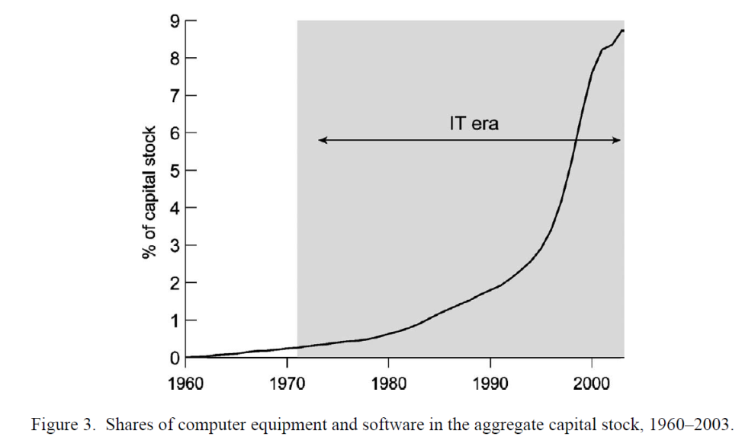
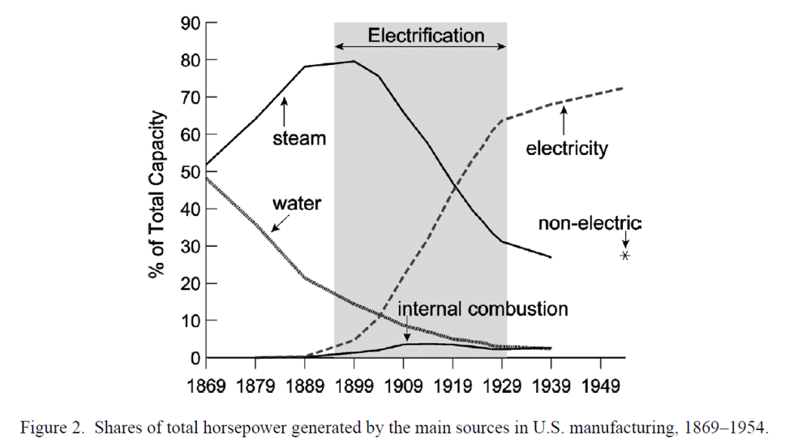
GPT growth models
Jovanovic & Rosseau (2005)

Slide 8
GPT: from enthusiasm to scepticism…
GPT were welcomed by economic historians as a more history-friendly view of economic growth than models based on steady-states
…in fact, the notion of GPT is not really suitable of compelling empirical “operationalization” leading soon to scepticism
- Field (2008)…but before David & Wright (1999), Crafts (2004)

Slide 9
Technological Systems and Development Blocks
CF, FL an CP did not use the GPT notion.
Technological system» (coming from B. Gille) or «techno-economic paradigm»:
Constellation of radical innovations with strong economic and technological linkages
«TS are associated with...wavelike movements in the economic and social system»

Slide 10
The first industrial revolution
There are two industrial revolutions:
Mechanization: the substitution of machines for human labor and skill
Steam: the substitution of fossil fuels for muscles, wind, water power, etc.
They proceed at different paces with different timings, gradually merging and mutually reinforcing each other.
But it is important not conflate their origins.

Slide 11
The first industrial revolution: steam
Different technological paradigms...
Newcomen
Watt
High pressure
Corliss, etc. (Rosenberg & Trajtenberg)
This is one GPT ? Are these multiple GPTs?
Can we deal with this heterogeneity using the notion of GPT ?

Slide 12
Newcomen steam engine
Watt steam engine
Trevithick steam engine
Legend:
Contri-buting innovation
1680 | 1700 | 1720 | 1740 | 1760 | 1780 | 1800 | 1820
Steam mobile applications
1784 Murdock auto locomotief
1801 Puffing Devil
1808 Catch Me Who Can
1814-1818 Stephenson locomotief
Basic innovation
1774 Wilkinson boring machine
Derived innovation
1783
Henry Cort puddling process
Era of
Transpor-tation
Supporting innovation
Smeaton steam engine 1777
1800+ Watt rotary engines
Desaguliers
1718
1788
Watt
‘Double acting’ engines
Papin’s piston 1690
1812 Cornish boiler
Era of
Steam power
Engine related Patent
Steam
stationary
applications
Steam
stationary
applications
1712 Newcomen Atmospheric Steam engine
1769
James Watt
Condensing Steam engine
1802
Trevithick Pressure Steam engine
1782 Horn-blower steam engine
Savery’s pump 1698
1760
Patent 913
1769-1800
1802 Patent 2599 Vivian
1802-1816
1698
Patent 356
1698-1733
1815
Patent 3887 Stephenson
locomotief
1781
Patent 1298
1781-1785
Patents 1306, 1321,1431,1482
1810-1833
Trevithick Patents
time
Patent Protection
© B.J.G.van der Kooij (2015)

Slide 13
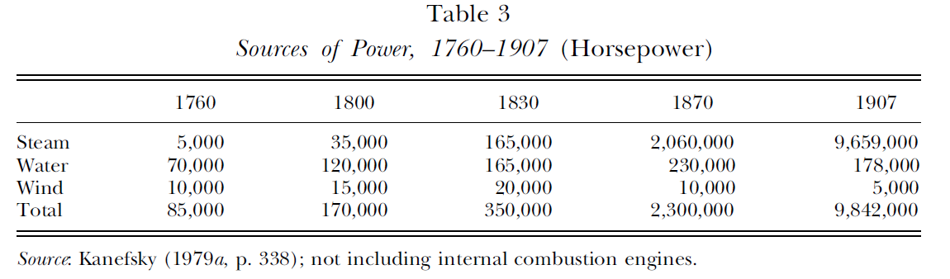

Slide 15
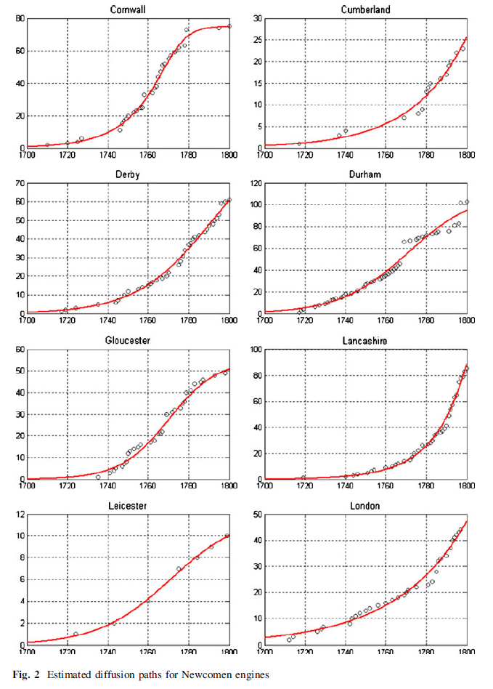
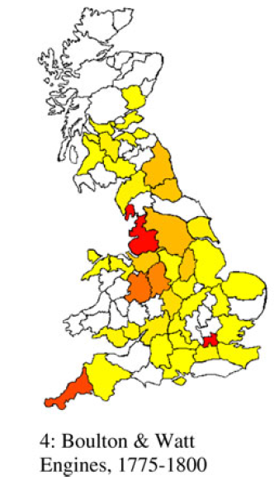
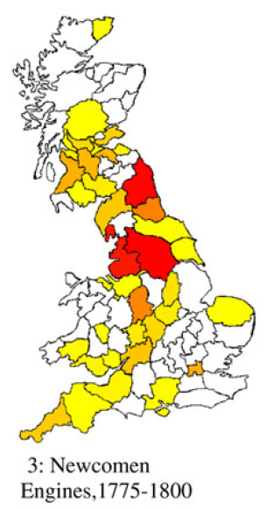
The early diffusion of steam-power, 1700-1800

Slide 16
Too many GPTs ?
Waterwheel, steam engine, electric dynamo, internal combustion engine, hybrid corn, biotechnology, three masted sailing ship, chemical engineering, railroads, automobiles, ICT, semiconductors, computer, internet, factory systems, mass production, lean production…
“One has only to consider the length of such proposed lists of GPTs to begin to worry that the concept may be getting out of hand. History may not have been long enough to contain this many separate and distinct revolutionary changes…” (David & Wright, 1999)

Slide 17
CF’ notions of technological system is «broader» than GPT
TS constellation of innovations with «autocatalytic properties». But also phases of «uneven» development among the components (eg Moore’s Law vs. Whirt’s Law)
TS also suitable of being connected with «leading sectors» (Rostow, cfr. 3° edition of Stages) or «development block» (Dahmen).
This can permit a more refined empirical appraisal of the links between technical change and the dynamics of productivity growth.
Freeman and Louca have pointed to a number of mechanisms such as backward and forward linkages, technological spillovers, investment multipliers of particular technologies, etc., that might indeed account for the economy-wide repercussions of the diffusion of these technological systems.
However, the assessment of the actual workings of such mechanisms so far has been mostly appreciative (main exception is Von Tunzelmann, 1978). Much more research waiting to be done ! More data and sources are available

Slide 18
Derived innovation
Electric
Dynamo
AC-electric
motor
Legend:
Engine related Patent
Contri-buting innovation
Basic innovation
Electric light
applications
1830 | 1840 | 1850 | 1860 | 1870 | 1880 | 1890
DC-electric motor
1884 Spraque DC-motor
Electric power
applications
1887 Diehl DC-motor
Gerard Moll (1830)
Clark (1840)
Davidson (1839)
1865
Farmer dynamo
1890 Tesla/ Scott 2ph-motor
1893 Stanley/ Kelly 2ph-motor
1861 Sinsteden dynamo
1887 Bradley 2phase motor
William Ritchie (1832)
Farmer (1846)
1878
Siemens A/B/C dynamo
1890 squirrel cage rotor
Wheat-stone (1841)
DC- Dynamo’s
Gramme dynamo (1870)
1888
Brown 3phase motor
AC-Electromotive
applications
Generating
applications
1896 Westing-house Type C motor
1834
Von Jacobi
Davenport
DC electro magnetic engine
Froment (1844)
1866
Varley, Siemens ,
Wheatstone
Self-exciting dynamo
1888
Tesla, Drobrowolsky AC-Induction motor
DC- Electromotive
applications
1876
Varley compound dynamo
Colton (1847)
1887
Tesla: 2phase motor
1863
Wilde dynamo
1888
Dobro-wolsky 3phase motor
Brush Dynamo 1877
1841 Wheat-stone
GB patent 9022
1887
Tesla
US-Patent 381.970/ 382.280
1889 Dobro-wolsky
Ge-Patent 56.359
1837 Davenport US Patent 132
1867
Varley
UK patent 4905
1867
Siemens
UK patent 261
time
© B.J.G.van der Kooij (2014)

Slide 19
The macro-trajectories of the ICT revolution
Years | Semiconductors | Computers | Software | Networking
1940-1950 | 1947: Point contact transistor (Shockley, Brattain, Bardeen; Bell Lab) | 1944: Colossus Mark II (Tommy Flowers; Bletchey Park)
 |  | 1945: ENIAC(Eckert & Mauchly; University of Pennsylvania)
1950-1960 | 1954: Silicon based transistor (Gordon Teal; Texas Instruments) | 1951: UNIVAC I (Remington Rand) | 1952: A-0 compiler (Grace Hopper)
 | 1958: Integrated circuit (Jack Kilby, Texas Instruments) | 1953: IBM 701 (IBM) | 1957: FORTRAN
 | 1958-9: Silicon oxide insulation in integrated circuit (Jean Hoerni, Robert Noyce; Fairchild) | 1954: IBM 650 (IBM) | 1960: COBOL 1960: LISP (John McCarthy)
 |  | 1958: Solid state 80 (Sperry Rand) | 1963: ASCII
 |  | 1959: IBM 1401 (IBM) | 1964: BASIC (Thomas Kurz, John Kemeny)
1960-1970 | 1965: Moore’s law (Gordon Moore; Fairchild) | 1965: PDP 8 (DEC) [first mini-computer] | 1964: OS/360 (IBM) | 1960: Dataphone (1st commercial modem; AT&T)
 | 1967: MOS chip (Fairchild) |  | 1969: UNIX (Kenneth Thompso, Dennis Ritchie; AT&T)
1970-1980 | 1971: Intel 4004 micro-processor (Federico Faggini, Intel) | 1973: Micral | 1979: VisiCalc ( Daniel Bricklin, Robert Franckston) | 1970: ARPANET
 | 1972: Intel 8008 (Intel) | 1975: Altair |  | 1971: ALOHANET (University of Hawaii)
 | 1976: Zilog Z80 | 1977: Apple II (Steve Jobs and Steve Wozniak; Apple) |  | 1973: Ethernet (Robert Metcalfe; Xerox PARC)
 | 1979: Motorola 68000 | 1979: Atari 800 |  | 1975: Telenet
1980-1990 | 1985: Intel 80386 (Intel) | 1981: Osborne I (Adam Osborne) | 1981: MS-DOS
 |  | 1981: IBM 5150 (IBM) | 1982: Lotus 1-2-3 (Mitch Kapor)
 | 1986: optical transistor (David Miller; Bell Lab) | 1982: Commodore 64 (Commodore) 1982: ZX Spectrum (Sinclair) | 1983: GNU (Richard Stallman)
 |  | 1983: Lisa (Apple) | 1984: Mac OS (Apple)
 |  | 1984: MacIntosh (Apple) | 1985: Windows 1.0 (Microsoft)
1990-2000 | 1993: Intel Pentium (Intel) |  | 1990: Windows 3.0 (Microsoft) | 1990: HTML (Tim Berners Lee, CERN)
 |  |  | 1991: LINUX (Linus Torvalds) | 1993: MOSAIC (Eric Bina, Marc Andreesen; University of Illinois)

Slide 20
Kondratiev waves: Freeman & Louca
Kondratiev Wave | Constellation of innovations/Technological systems | Approximate timing: upswing (dowswing)
First | Water-powered mechanization of industry | 1780-1815/(1815-1848)
Second | Steam-powered mechanization of industry and transport | 1848-1873/(1873-1895)
Third | Electrification of industry, transport and the home | 1895-1918/(1918-1940)
Fourth | Motorization of transport | 1941-1973/ (?)
Fifth | Computerization of the entire economy | ??/(??)

Slide 21
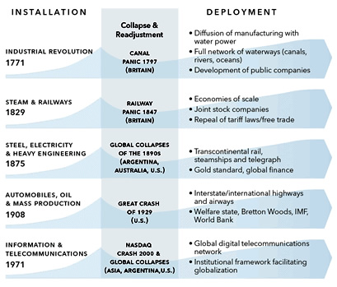
Kondratiev waves: Perez

Slide 22
“The entire life cycle of a TS will be usually much more than a century” (Freeman & Louca, 2001)
Precise chronological characterization of the diffusion process of a TS is difficult
Layers of different TS are likely to overlap and coexist (eg, from a technological point of view Italian’s industrialization is a “mix” of the I, II, and III Kondratiev)
A more flexible periodization based on the notion of First, Second, and Third Industrial Revolution is perhaps more fruitful ? (Von Tunzelmann, 1995)
According to Von Tunzelmann each IR is characterized by two “clusters” of innovation (the first dominated by process the second by product innovations)

Slide 23
Industrial Revolutions and the Sources of Innovation

Slide 24
Conclusions
CF and long-run capitalist development: a challenging research agenda (still unfulfilled....)
CF’s approach to this theme is radical, but at the same time open and not-dogmatic.
GPT models not so useful or insightful (rapidly getting out of fashion ?)
«Technological systems» seems more promising (at least for an economic historians).
Kondratiev periodization may be too rigid (alternative IR periodization is less contentious and more flexible)
Still a lot of work is needed in terms of assessing the productivity impact of technological systems
It can be useful to think to the process of long run economic growth in more disaggregate terms: leading sectors, development blocks (data are becoming increasingly available), rather than with aggregate growth models
Industrial dynamics grounded in a «grand view» of capitalist development (even if this is a tentative characterization)

